Slide 1
Bio211 Biostatistics and Experimental Design Winter Term 2018
Lecture 8 Correlation and Regression
January 26, 2018
Notes:
THIS LOOKS SUPER HELPFUL!
https://www.r-bloggers.com/correlation-and-linear-regression/

Slide 2
Outline for today
Assignment 7 due today
Review a couple of things…
Correlation
Practice in R
Linear Regression I
Practice in R

Slide 3
Review
Talk about data analysis and statistical analysis in methods!!!

Slide 4
Format for final paper
Methods
Experimental design
Data collected
Data Analysis
Results
Overall summary
Results of analyses (refer to figures or tables in text)
Figures with legends

Slide 5
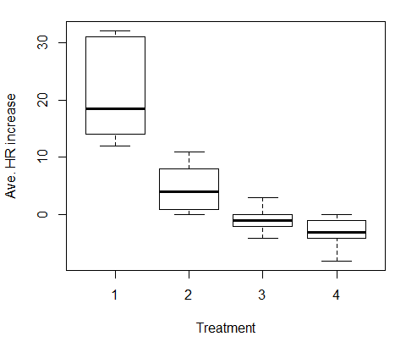
Review ANOVA post hoc tests
aov(HR_increase ~ treatment)
P < 0.001

Slide 6
Review ANOVA post hoc tests
aov(HR_increase ~ treatment)
P < 0.001
P =?
P =?

Slide 7
Post hoc after Kruskal-Wallis
This is not review…
Dunn test for multiple comparisons

Slide 8
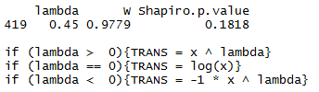
transformTukey() output

Slide 9
Correlation and Regression

Slide 10
When to use correlation and regression?
Effect and response variables are continuous, numeric variables
Examples?

Slide 11
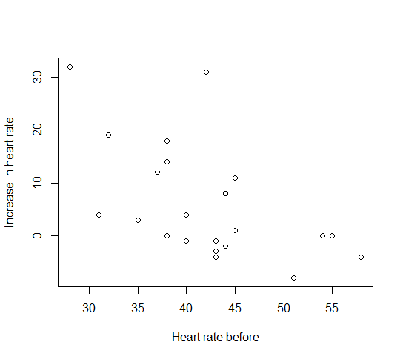
Example: starting heart rate and increase in heart rate

Slide 12
Correlation
Is one measurement variable associated with another measurement variable (P value)?
If the value of one variable increases, does the value of the other tend to increase (or decrease)?
What is the strength of the association (r or r²)?

Slide 13
Is the increase in heart rate associated with the starting heart rate?
P = 0.006

Slide 14
What is the strength of that association?
r = -0.56

Slide 15
What is the strength of that association?
r² = 0.31
31% of the variation in the variation in increase HR is explained by starting heart rate

Slide 16
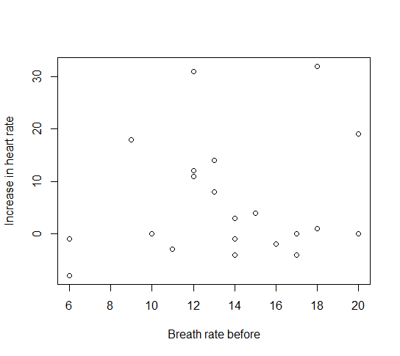
Another example
P = 0.5
r = 0.15

Slide 17
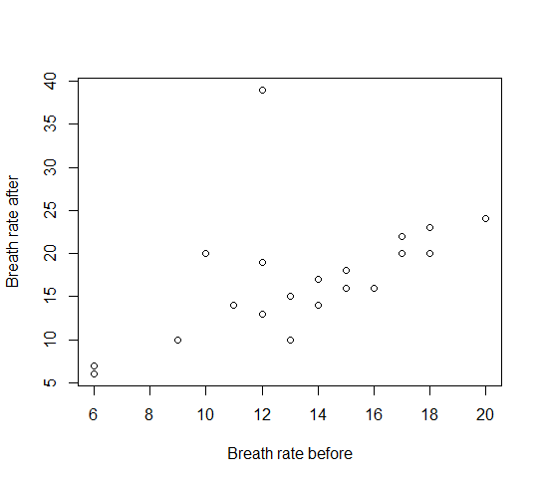
Last example
P = 0.009
r = 0.54

Slide 18
Correlation
Sampling natural variation of both variables
NOT actively picking values of either variable
H₀: There is no association between the effect variable and the response variable
Assumptions: both variables are normally distributed
Makes no statement about causality!!
In the case of a positive correlation, the increase in y is not necessarily caused by the increase in x. It could be that the increase in x is dependent on the increase in y

Slide 19
Non-normal data?
Spearman’s rank

Slide 20
Practice in R!

Slide 21
Linear Regression
Find a line that goes through the cloud of points and use that line to predict values
Minimizes the squared vertical distances between the data points and the line
Must use fixed values of independent variable!
H₀ : there is no relationship between the values of the effect and response variables

Slide 22
Linear Regression
Y = mX + b + ϵ
Y is a linear function of X with normally distributed errors, ϵ.
b is y intercept of line
H₀: m (slope of line) is not different from zero

Slide 23
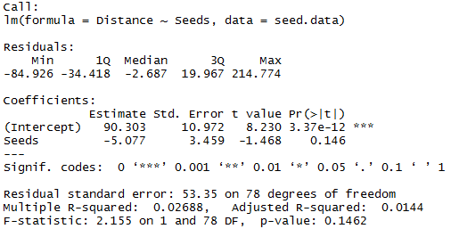
Example in R
Notes:
Intercept of line, slope of line, if intercept is sig dif from 0, if slope is sig dif from 0, and r squared values

Slide 24
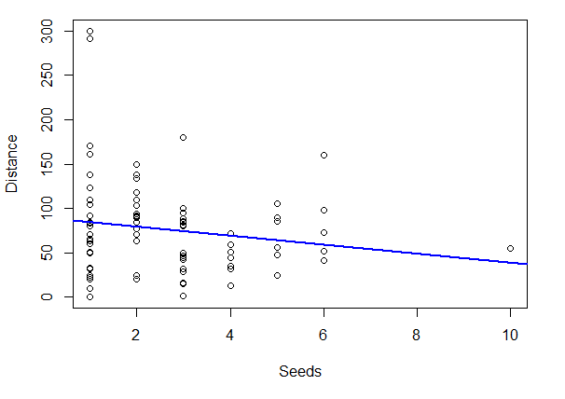
Residuals: distance from each point to best fit line

Slide 25
Summary
No lab today!
Assignment 8 due Monday morning before lecture

Slide 26
Important for your homework
I’ve asked you to run a post hoc test on the ANOVA you ran for assignment 7
You will need to make the seeds column a factor to run the post hoc tests
data$Seeds<-as.factor(data$Seeds)

